Slide 1
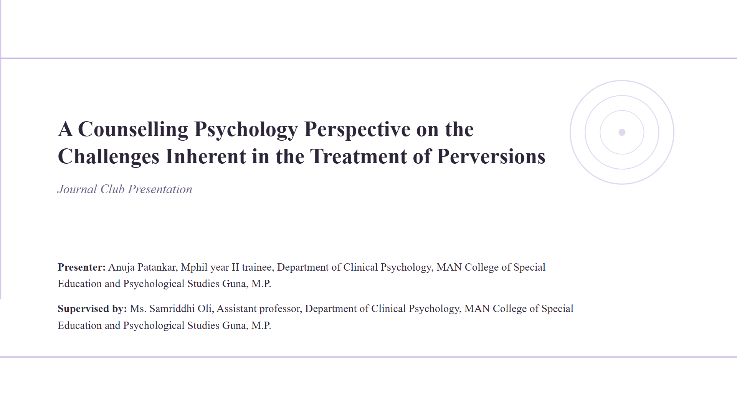
Increasing engagement with cognitive-behavioral therapy (CBT) using generative AI: A randomized controlled trial (RCT)
Journal Club Presentation
Presenter:
Anukruti Rohini, M.Phil. Clinical Psychology trainee, Department of Clinical Psychology, MAN College of Special Education and Psychological Studies Guna, M.P.
Supervised by:
Dr. Ajay Sharma (HOD and Professor), Department of Clinical Psychology, MAN College of Special Education and Psychological Studies Guna, M.P.

Slide 2
Paper at a glance
McFadyen et al. (2026)
THE QUESTION
Can a genAI-enabled CBT app improve engagement and symptoms compared with a static digital CBT workbook?
Increasing engagement with cognitive-behavioral therapy (CBT) using generative AI: a randomized controlled trial (RCT)
Communications Medicine Article in Press • DOI: 10.1038/s43856-025-01321-8
02

Slide 3
Rationale of the study
THE CLINICAL GAP
Long waits and gaps between therapy sessions leave many people without adequate support.
CBT homework is clinically useful, but consistent engagement is difficult.
Static digital materials are scalable yet often generic and easy to abandon.
THE PROPOSED SOLUTION
Personalized, interactive genAI may make self-directed CBT feel more responsive and usable.
But mental-health AI must also be clinically safe.
03

Slide 4
Objectives and hypotheses
01 ENGAGEMENT
02 SYMPTOMS
03 SAFETY
Test whether the genAI app increases frequency and duration of use.
Compare change in anxiety and depression symptoms over 6 weeks.
Compare adverse events and explore which features relate to benefit.
Hypothesis: personalization would increase engagement and may translate into better clinical outcomes.
04

Slide 5
Study design
SCREEN
BASELINE
6 WEEKS
ENDPOINTS
1
2
3
4
Online eligibility (N = 2,146)
540 adults randomized 3:2
Self-directed CBT weekly surveys
Engagement • symptoms safety • experience
Parallel • unblinded • active-control RCT | ClinicalTrials.gov: NCT06459128 | UCL REC approval
05

Slide 6
Participants and retention
SAMPLE
RETENTION
N = 540
≈ 85%
Adults in the United States with elevated GAD-7 or PHQ-9 scores
Average weekly survey completion Week 6: 82.9% app vs 83.0% control
Randomized allocation (3:2)
Modified intention-to-treat analysis: 322 intervention + 209 active control (9 control participants excluded after cross-exposure).
06

Slide 7
What did participants receive?
GENAI APP | LIMBIC CARE
ACTIVE CONTROL | DIGITAL WORKBOOK
Conversational, personalized CBT delivery
“Let’s Chat” emotional support
Psychoeducation + interactive CBT activities
Guided sessions with tailored exercise suggestions
Same CBT curriculum and three course options
Static text, images and response boxes
Modeled on evidence-based NHS materials
Viewable on phone, tablet or computer
The curriculum was matched; the delivery mechanism was the experimental contrast.
07

Slide 8
Outcomes and measures
ENGAGEMENT
CLINICAL
Frequency of opens Total duration
GAD-7 anxiety PHQ-9 depression
FUNCTION
SAFETY / UX
WSAS impairment MSQ sleep symptoms
Adverse events Usability & trust
Primary measures were collected weekly across the six-week intervention period.
08

Slide 9
Analysis plan
PRIMARY ANALYSIS
SAFETY
EXPLORATORY
Linear mixed-effects models
Group, week and group × week
Random intercepts for participants
Bonferroni correction for clinical outcomes
Weekly adverse-event reports
Logistic regression
Multiple imputation (MICE)
Bayesian sensitivity analyses
Engagement duration
App feature use
Guided-session subgroup
Hypothesis-generating only
09

Slide 10
Baseline profile: broadly comparable groups
KEY CHARACTERISTICS
Female: 72.3% control; 69.6% intervention
White: 70.3% control; 69.6% intervention
Prior therapy: ≈ 53% in both groups
Current psychoactive medication: ≈ 22% in both groups
Mean baseline symptom scores
Mean age: 36.0 years control vs 37.6 years intervention.
10

Slide 11
Result 1 | Engagement frequency increased
WEEK 6
5×
The app was opened more frequently than the workbook by the final week.
p < .001 | f² = .073
2.4× more opens with the genAI app
11

Slide 12
Result 2 | Engagement duration was longer
ABSOLUTE USE
60.7 vs 15.9 min
App engagement remained higher throughout the study and the gap widened by Week 6.
p < .001 | f² = .067
3.8× longer time engaged
12

Slide 13
Result 3 | Symptoms improved similarly
NO BETWEEN-GROUP DIFFERENCE
Both groups improved, but the app was not superior to the workbook for anxiety or depression.
GAD-7 interaction p = .505 PHQ-9 interaction p = .315
Mean reduction from baseline (absolute points; higher = greater reduction)
13

Slide 14
Result 4 | Comparable safety profile
MONITORING
No serious adverse events met ISO criteria.
Only 1 of 190 intervention-group events mentioned the intervention negatively.
Crisis support was never required.
No significant group difference
Bayesian evidence supported no meaningful difference in adverse-event rates (BF₀₁ = 8.878).
14

Slide 15
Result 5 | The app felt more usable and personal
INTERPRETATION
Personalization was the clearest user-experience advantage (d = 0.56).
Satisfaction and perceived usefulness were not significantly different.
Significant advantages favored the app
15

Slide 16
Exploratory finding | Guided sessions may matter
FEATURES TESTED
SIGNAL
CAUTION
Let’s Chat
Psychoeducation
CBT activities
Guided sessions
Guided sessions
Post-hoc self-selection
Greater anxiety improvement and improved wellbeing.
Correlational—not causal.
16

Slide 17
Discussion: what the RCT supports
SUPPORTED
NOT SUPPORTED
IMPLICATION
GenAI can increase autonomous engagement.
Safety was comparable with a static CBT workbook.
More engagement did not produce superior overall symptom reduction in 6 weeks.
GenAI may be more valuable as a clinical amplifier than a therapist replacement.
Human guidance may help users reach potent features.
17

Slide 18
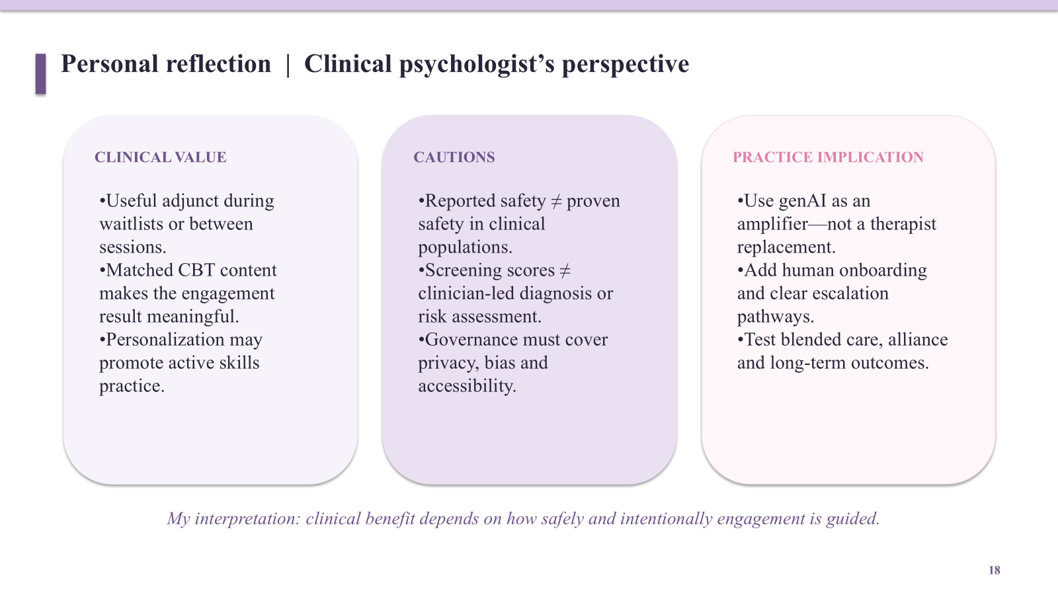

Slide 19
Strengths, limitations and next steps
STRENGTHS
LIMITATIONS
NEXT STUDIES
Randomized active-control design
Matched CBT curriculum
Objective engagement tracking
Pre-registered trial and safety monitoring
Unblinded, self-directed study
Screening scores—not diagnostic interviews
No inactive / waitlist control
Control workbook developed by same organization
Randomize access to guided sessions
Test blended human–AI care
Use independent comparator validation
Recruit clinically diagnosed samples
18

Slide 20
Take-home message
The genAI-enabled CBT app made self-directed therapy more engaging—but not more effective than a digital workbook for overall symptom reduction over six weeks.
The most promising signal was not “AI alone,” but personalized guided interaction—an important hypothesis for supervised, blended care.
Thank you
19

Slide 21
References | APA 7th edition
McFadyen, J., Habicht, J., Dina, L.-M., Harper, R., Hauser, T. U., & Rollwage, M. (2026). Increasing engagement with cognitive-behavioral therapy (CBT) using generative AI: A randomized controlled trial (RCT). Communications Medicine. https://doi.org/10.1038/s43856-025-01321-8
American Psychological Association. (2017). Ethical principles of psychologists and code of conduct. https://www.apa.org/ethics/code
Mausbach, B. T., Moore, R., Roesch, S., Cardenas, V., & Patterson, T. L. (2010). The relationship between homework compliance and therapy outcomes: An updated meta-analysis. Cognitive Therapy and Research, 34, 429–438. https://doi.org/10.1007/s10608-010-9295-5
Peipert, A., Krendl, A. C., & Lorenzo-Luaces, L. (2022). Waiting lists for psychotherapy and provider attitudes toward low-intensity treatments as potential interventions. JMIR Formative Research, 6, e39787. https://doi.org/10.2196/39787
Gutheil, T. G., & Gabbard, G. O. (1993). The concept of boundaries in clinical practice: Theoretical and practical implications. The American Journal of Psychiatry, 150(2), 188–196. https://doi.org/10.1176/ajp.150.2.188
Pope, K. S., Sonne, J. L., & Greene, B. (2006). What therapists don’t talk about and why: Understanding taboos that hurt us and our clients. American Psychological Association.

